Slide 1




Minimum Information for Plant Phenotyping Experiments (MIAPPE)
Plant science data management and integration

Slide 2
Plant Phenotyping standards: WHY

Slide 3

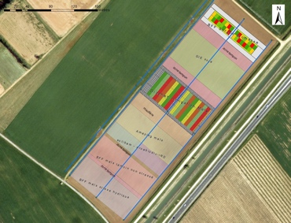
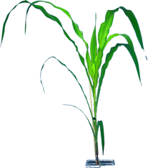
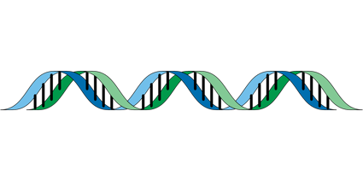

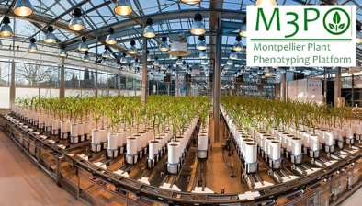
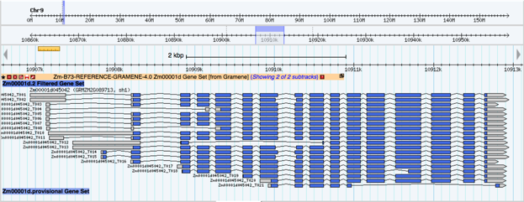


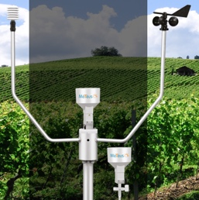
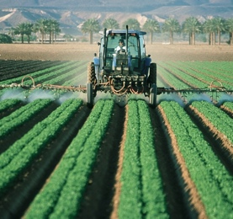
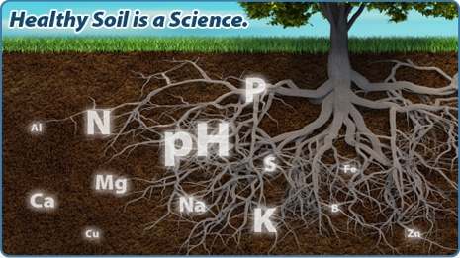
Genome / Environment / Phenome
Phenomics
Genetics
Genomics
Omics
Plant Breeding
Genetic variations by Traits
Mostly centralized
Homogenous data
Heterogenous metadata
Dispersed
Heterogenous
Getting Standardized
Climate Change Studie
Genotype by Environment
Environment
Dispersed
Heterogenous

Slide 4
Why should we standardize phenotyping data?
To enable anyone (including yourself) to reuse it: metadata about the experiment (who did it, for what purpose, where and how)
To enable the (automatic) integration with other types of data: Linked data between datasets using identification of pivot objects
Phenotype 1 = measurement on a cultivar in an environment-GPS1-time1
Phenotype 2 = measurement on a cultivar in an environment-GPS2-time2
Genotype = observed marker’s alleles on a cultivar
Climate 1 = climatic data at GPS1-time1
To enable knowledge discovery: metadata about the experiment, controlled vocabularies, ontologies

Slide 5

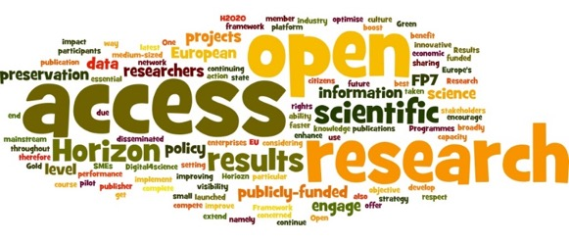

Europe open access and interoperability policy
Open Access
FAIR
Cadre national PNSO2 (Open Data)
Décret Décembre 2021 (Données brutes préservées)
Projets Européens: WP en support du plan de gestion des données (FAIR Compliant)
Création de valeur

Slide 6

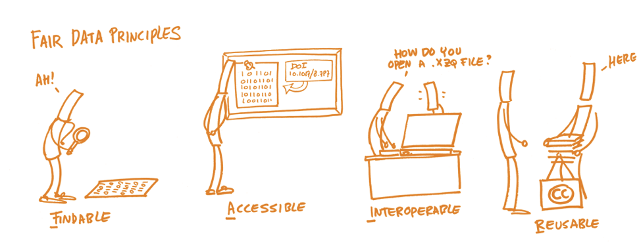
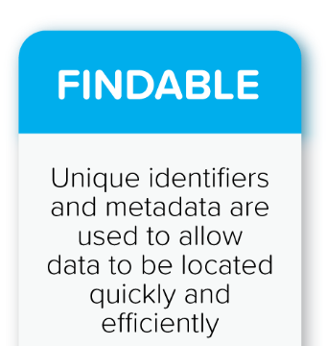

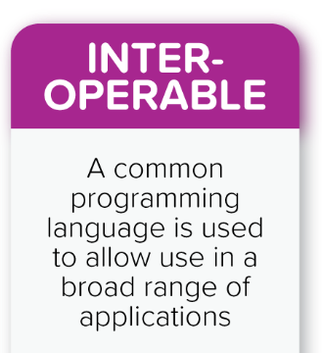
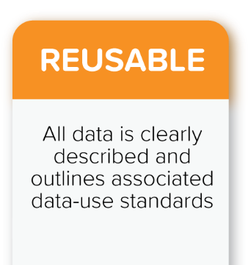
FAIR Data Principles
Wilkinson et al., The FAIR Guiding Principles for scientific data management and stewardship. Scientific Data 3 (2016)
License
Well described
Provenance
Standards
Ids
Metadata
Index
Open Protocole
Perenial Metadata
Technical & Data (Semantics
Linked Data
Vocabularies)

Slide 7
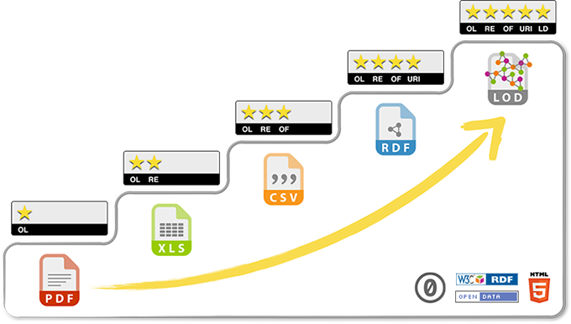
5 stars Open Data
related to other data
identified by URI
non-proprietary format
in a structured format
Data on the web, open licence
Progressing towards FAIR and Open Data requires a multidisciplinary cooperation :
Biologists
Bioinformaticians
Specialists of ontologies/semantics

Slide 8
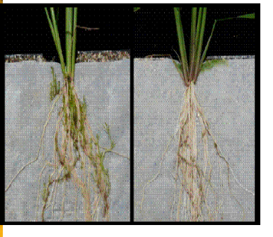
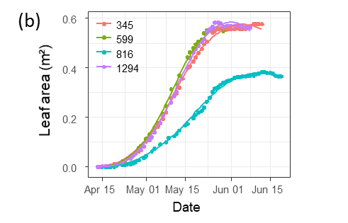

Phenotyping data life cycle
Data acquisition
Data computation
Knowledge
« Raw » data, pheno/env measures, variables
« computed » data, reduced, indicators
Soissons x high N
Charger x high N
Charger x low input
Soissons x high N
Charger x high N
Soissons x low input
Soissons x low input
Soissons x high N
Derivation, Reduction
Soissons x low input
Charger x low input
Charger x high N
Soissons x high N
Soissons x high N
Genotype | Treatment | N input | Date | Rep | Fusariose
Soissons | low input | 15,32253129 | 15/11/2011 | 1 | 5
Soissons | low input | 15,31430556 | 16/11/2011 | 2 | 7
Genotype | Treatment | Fusariose
Soissons | low input | 6

Slide 9
Phenotyping data life cycle
Knowledge
Data acquisition
Data computation
« Raw » data, pheno/env measures, variables
« computed » data, reduced, indicators
Variety charger is resistant to fusariose under intensive cultural practice
Soissons x high N
Charger x high N
Charger x low input
Soissons x high N
Charger x high N
Soissons x low input
Soissons x low input
Soissons x high N
Derivation, Reduction
Publication
Soissons x low input
Charger x low input
Charger x high N
Soissons x high N
Soissons x high N
Genotype | Treatment | N input | Date | Rep | Fusariose
Soissons | low input | 15,32253129 | 15/11/2011 | 1 | 5
Soissons | low input | 15,31430556 | 16/11/2011 | 2 | 7
Genotype | Treatment | Fusariose
Soissons | low input | 6
VARIABLES
Traceability
Raw measures
Data Cleaning
Platform IS (Emphasis IS, PHIS, …)
Reproducibility & Provenance
INDICATORS
New computation for each scientific question
One raw dataset → many computed datasets
Raw data long term
conservation

Slide 10
Plant Data StandardS : WHO

Slide 11






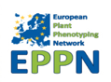






Interoperability in International network
National
Networks
European
Networks
Global Networks
International data standards
Web services
Minimal information
Controlled vocabularies
Trait dictionaries
MCPD
Notes:
11

Slide 12
Plant data standards contributors
Gathered to solve interoperability standard problem
ELIXIR
European Infrastructure for life sciences
Germany, France, Belgium, Italy, Portugal, UK, Netherland, Slovenia, …
https://elixir-europe.org/communities/plant-sciences
CGIAR
Consortium of International Agricultural Research Centers
https://www.cgiar.org/
EMPHASIS
European Infrastructure for Plant Phenotyping
France, Germany, Belgium, UK, …
https://www.plant-phenotyping.eu
NAPPN
North American Plant Phenotyping Network
https://nappn.plant-phenotyping.org/

Slide 13
Plant Data StandardS : WHAT

Slide 14




Data standards for FAIR
Structure
Formatting, Modelling and Organizing Data
Standards : CSV, VCF, GFF, MIAPPE , etc…
Dataset : greenhouse, field, multiannual, multilocal
Variables and plant material
Biologist & Computer scientist driven
Semantic
Description of the data
Controlled vocabularies: term name and definitions
Ontologies: semantic links between terms
Phenotyping/environment
Biologist driven
Persistent Unique Identifiers
URI, sensor ID, accessions ID, Trait ID, DOI,…
Technical
Data integration and sharing
Interoperability : tools and systems
GA4GH
Breeding API www.brapi.org
Computer scientist driven

Slide 15



Phenotype Semantic Standard: Ontologies
Describing traits/features in specific plant species
Crop Ontology Trait + Method + Scale Semantic model
TRAIT = Entity + Characteristic
EMPHASIS variables

Slide 16

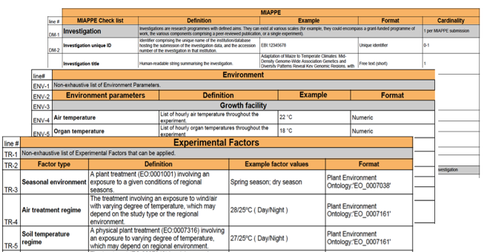
Plant Structure Standard
Minimal Information About Plant Phenotyping Experiment : version 1.1 (Jan 2019)
www.miappe.org
Many stakeholders
Elixir, Emphasis, Bioversity, North American PPN
Open Community:
Request for comments
Github Feature requests
Mailing lists
Meetings & Workgroups
Crops and woody plants

Slide 17
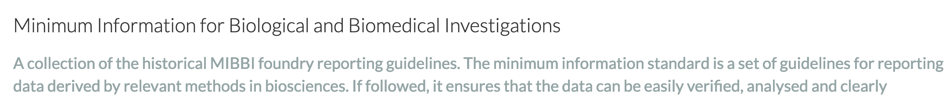
Plant Structure Standard : MIAPPE
Biologist Friendly
Clear definitions and examples
Excel templates
Trainings
Minimal and sufficient list of metadata:
The objective of the experiment
Who contributed to the experiment
What were the experimental procedures
What was the biological material experimented
...

Slide 18
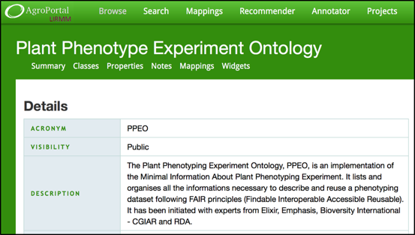




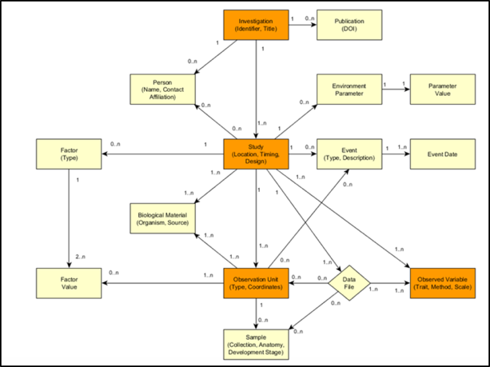
Plant Structure Standard
Computer scientist friendly :
Explicit Data Model: ISA-Tools and Breeding API (BrAPI) compatibility.
Validation framework and toolbox
Specification with multiple implementations
Semantic: Plant Phenotyping Experiment Ontology
Web Service: Breeding API
File Archive: ISA Tab
Databases: GnpIS, data.inrae.fr, BrAPI compliant databases(PHIS, …)

Slide 19
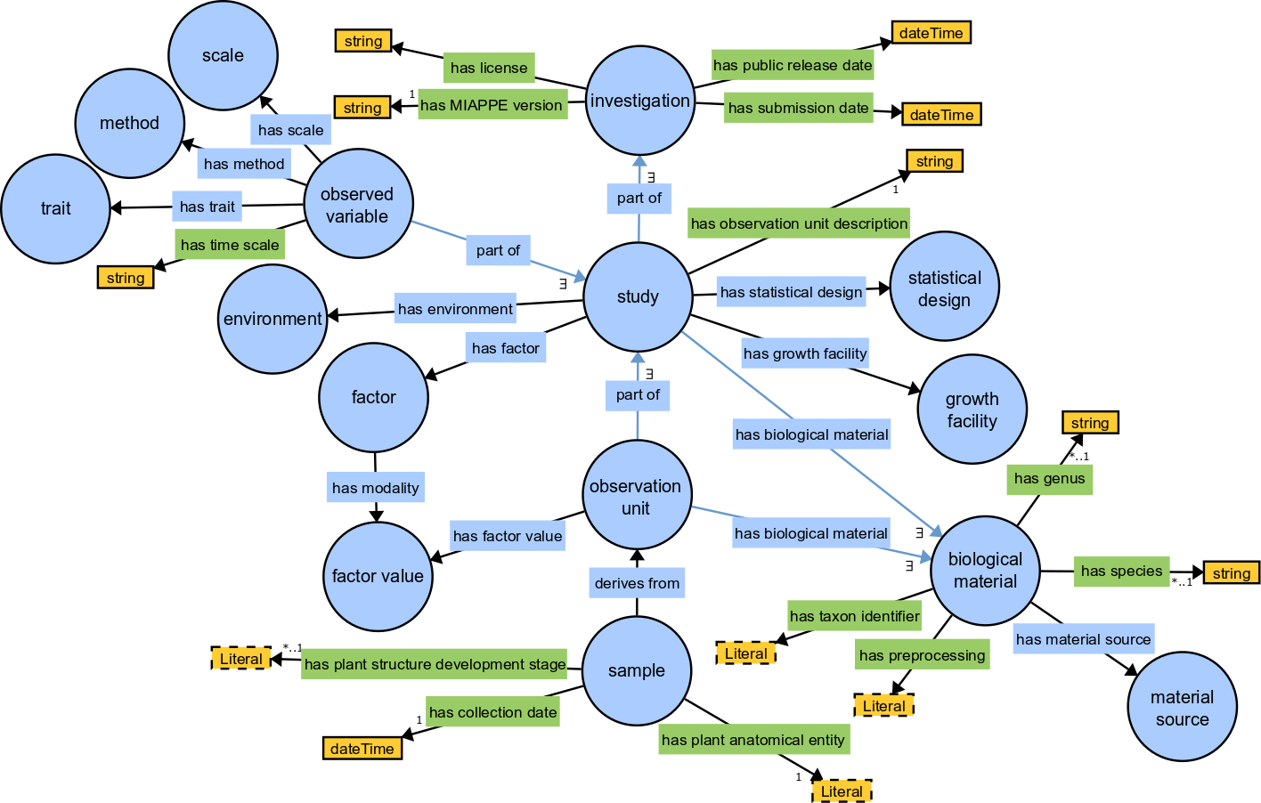
MIAPPE Semantic: PPEO
MIAPPE OWL Implementation
https://github.com/MIAPPE/MIAPPE-ontology
http://agroportal.lirmm.fr/ontologies/PPEO
Data model representation
Formal concepts and constraints
Ontology for Computer scientists, not for biologists

Slide 20









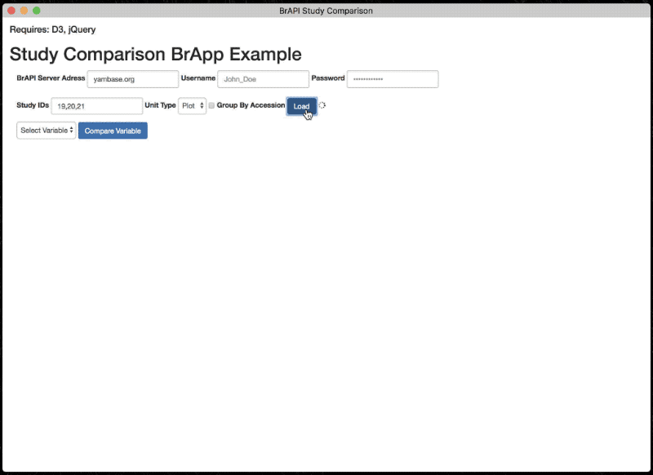
Plant Technical Standard
Breeding API http://brapi.org/
International collaboration
Standard Open Web Service API
Information Exchange, Main target: Breeding
Excellence in Breeding platform (CGIAR, Peter Selby)
Major Elixir, Emphasis Contribution
Phenotyping specification
Connect data repositories and tools:
Genotype visualization (Flapjack)
Studies graph preview and filtering
BrAPPS : Tools integrable in any BrAPI compliant System
https://www.brapi.org/brapps.php
R analysis environment
Field data capture
FAIR Data discovery → Elixir FAIDARE
T3
CIRAD
GOBII
Wageningen
Cornell
iPlant
Selby et al. Bioinformatics (2019),
doi.org/10.1093/bioinformatics/btz190

Slide 21
Standardized Specification
BrAPI has defined a Standardized set of data model structures to communicate the basic information of plant breeding
BrAPI is a technical Specification which software developers can easily turn into code which communicates using the Standard.
BrAPI 101 Slides, P. Selby

Slide 22

BrAPI data model
MIAPPE compliant
MIAPPE Investigation → BrAPI Trial
MIAPPE Study → BrAPI Study
Biological Material Germplasm MCPD dedicated BrAPI calls
Observation variable BrAPI calls
Datafile or Observation Unit
Phenotyping
Studies
Genotyping
Studies
Germplasm
Permanent Unique Identifier (DOI)
AccessionNumber
Taxon
Institute (→ Namespace)
Observation Units
(Plants, Plots, …)
Observations
(Env, Pheno, …)
Observation Variables
Trait
Methode
Scale

Slide 23
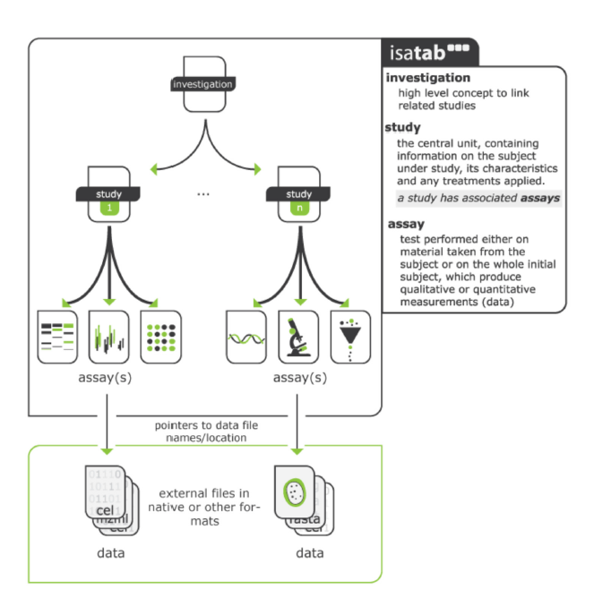
MIAPPE File Archive
ISA Tab for Phenotyping
Investigation/Study/Assay
Zip Archive
MIAPPE Metadata
Raw data
CSV
Images or binary files
Reference to image archive (URI/URL)
Elaborated data
CSV
Provenance
Training and improvements
File and metadata curation
Elixir
Célia Miguel & Anne Françoise Adam Blondon
BrAPI to IsaTab portable tool
Elixir implementation study for MIAPPE Validation
Data files

Slide 24
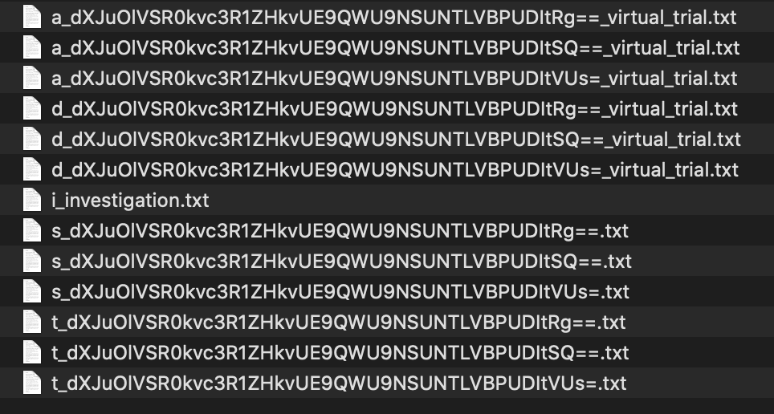
MIAPPE File: Poplar Phenology dataset
Zip archive
1 investigation
i_Investigation.txt : initial file
3 Studies
3 s_*.txt file
1 level per study
3 a_*.txt
3 trait definition file
Crop ontology format
T_*.txt files
3 data files
D_*.txt file

Slide 25

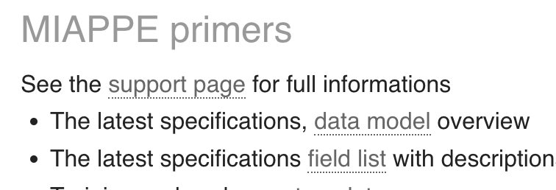
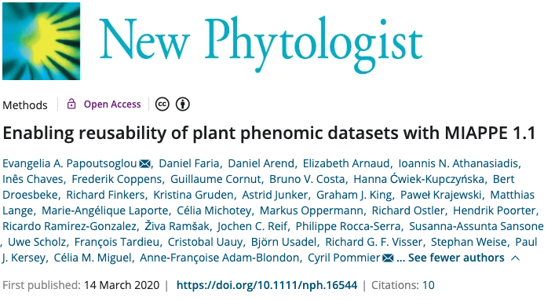
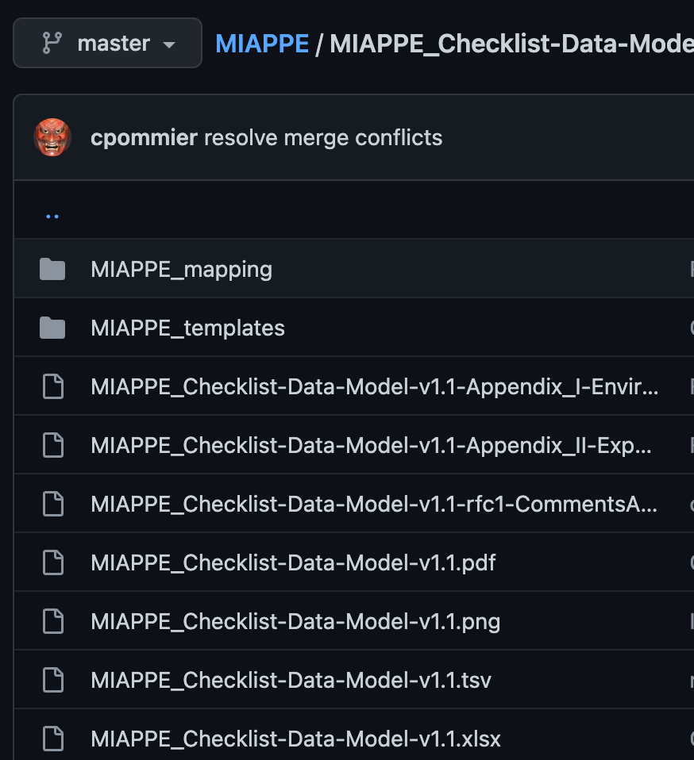
MIAPPE Specifications
www.miappe.org
Github
https://github.com/MIAPPE/MIAPPE/tree/master/MIAPPE_Checklist-Data-Model-v1.1

Slide 26
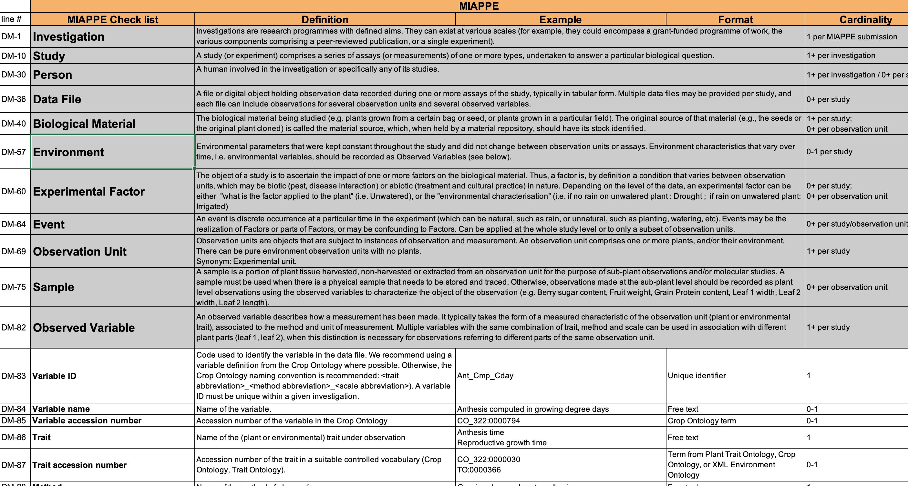
MIAPPE Specifications
Specification table
Sections
Metadata Fields

Slide 27
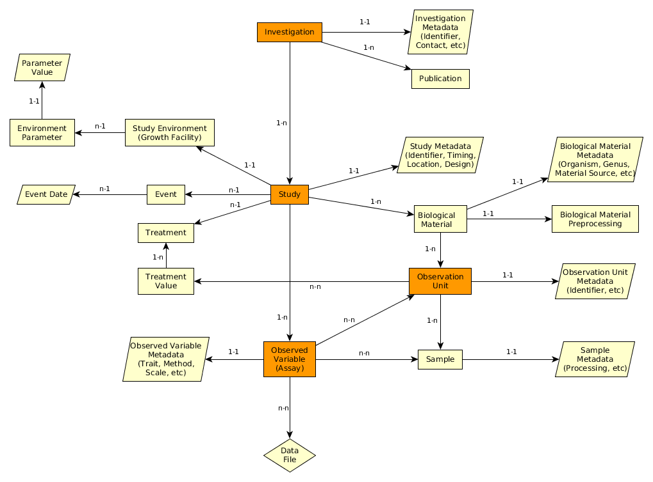
MIAPPE Specifications
Specification table
Sections
Metadata Fields
Linked and organized

Slide 28
MIAPPE V1.1 Overview the (ISA) backbone
Investigation: whole dataset
field, greenhouse,
One to many location
One to many years
Study : one experiment in one location for one to several year
Assay:
trait or indice (Pheno or Env) observed
Level + Trait + Method + Scale/Unit
Level:
Plant
Microplot
Block
Trial/Study
…
Investigation
Study
Assay
(Observed variable)
Data file

Slide 29
Simple examples in MIAPPE
Two examples to illustrate how to capture important information about the phenotyping experiments:
MAIZE: [1] Millet et al. 2019 (https://doi.org/10.15454/IASSTN): A multi-site experiment in a network of European fields for assessing the maize yield response to environmental scenarios.
POPLAR: [2] Monclus et al. 2012 (http://dx.doi.org/10.1186/1471-2229-12-173): Integrating genome annotation and QTL position to identify candidate genes for productivity, architecture and water-use efficiency in Populus spp

Slide 30
Millet et al 2019 [1] - Material&methods section on phenotyping experiments
A panel of 256 maize hybrids was grown with two water regimes (irrigated or rainfed).
Location: seven fields in 2012 and 2013, plus one site in Chile in 2013
This resulted in 29 experiments defined as the combination of one year, one site and one water regime, with two and three repetitions for rainfed and irrigated treatments, respectively.
A detailed environmental characterisation was carried out, with hourly records of micrometeorological data and soil water status, and associated with precise measurement of phenology.
« grain.yield»: yiel adjusted at 15% grain moisture, in ton per hectare (t ha-1). «grain.number»: number of grain per square meter. «grain.weight»: individual grain weight (mg). «anthesis»: male flowering (pollen shed), in thermal time cumulated since emergence (d20°C). «silking»: female flowering (silking emergence), in thermal time cumulated since emergence (d20°C). «plant.height»: plant height, from ground level to the base of the flag leaf (highest) leaf (cm). «tassel.height»: plant height including tassel, from ground level to the highest point of the tassel (cm). «ear.height»: ear insertion height, from ground level to ligule of the highest ear leaf (cm).

Slide 31
Monclus et al 2012 [2] - Material&methods section on phenotyping experiments
3 Field trial established in April 2003 located in France (Ardon, 47°49’41''N, 1°54’39''E, 110 m),Italy Cavallermaggiore ((44° 43' 0'' N) , (7° 41' 0'' E)), UK Headley ((51° 7' 0'' N) , (-1° 10' 0'' W) )
The biological material consisted of a cloned 336 F1 progeny from an interspecific cross between the female Populus deltoides (Bartr. Ex Marsh.) ‘73028-62’ from Illinois and the male P. trichocarpa (Torr. and Gray) ’101-74’ from Washington State.
The trial was established from 25 cm- homogenous hardwood cuttings planted at a plant density of 6670 trees per ha. The trial was and consisted in 6 randomized complete blocks where each F1 genotype and each parent was represented by one replicate.
Circumference and stem height were measured at the end of the first (winter 2003–2004) and second (winter 2004–2005) as described in Dillen et al. Forest Ecol Manag. 2007, 252 (1–3): 12-23). Growth increment in height and circumference during the second growing season were calculated.
Leaf traits where measured in 2003: one fully illuminated mature leaf was collected on each tree according to Monclus et al. http://doi.org/10.1111/j.1469-8137.2005.01407.x ). Six calibrated discs of lamina were cut from this leaf, dried at 50 °C during 48 °C and weighed, and specific leaf area (SLA, cm² g⁻¹) was computed. Leaf discs were ground to fine powder for analysis of leaf carbon isotope composition (δ¹³C), carbon (C_{M}) and nitrogen (N_{M}) contents. One-milligram subsamples of ground material were used for measuring the CO₂ produced by combustion and its ¹³CO₂/¹²CO₂ ratio by a continuous flux isotope ratio mass spectrometer. The discrimination between atmospheric CO₂ and plant material was calculated.

Slide 32
MIAPPE 1.1 Overview
Typical Dataset: Monclus et al., 2012, [2]
Populus deltoïdes
INRA:73028-62
doi:10.15454/1.4921786081024297E12
Data file
Data file
Data file
Data file
6 randomized blocks
1 observation unit = one tree
No treatment
6 replicates defined by their position in each block: row and column

Slide 33
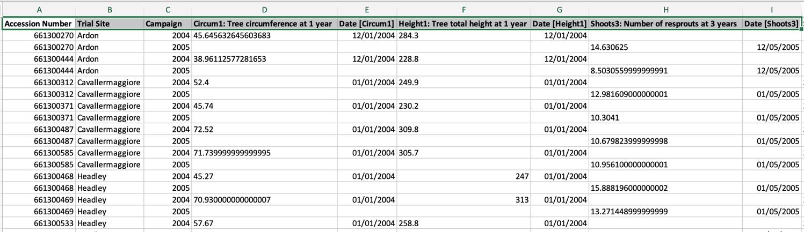
MIAPPE V1.1 Overview Data file content
Any format (Near Infra Red Spectrum, Images, Image Archives references, ….)
Mostly tabular
Metadata on each column header

Slide 34
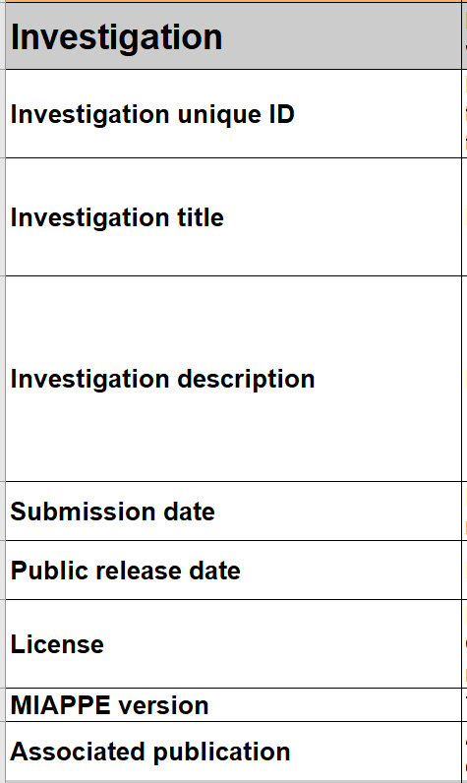
MIAPPE main sections – Investigation
Investigations are research programmes with defined aims.
They can exist at various scales: e.g. grant-funded programme of work with various published components; a single experiment.
=> One investigation holds one to many studies.
Metadata: similar to the information required for the deposition of a dataset in an archive attached to a DOI
=> title, description, associated publications/people, ...
Examples:
MAIZE [1]: the whole set of multilocal and pluriannual phenotyping experiments constitute the investigation
POPLAR [2]: the whole set of multilocal measurements over three years constitute the investigation

Slide 35
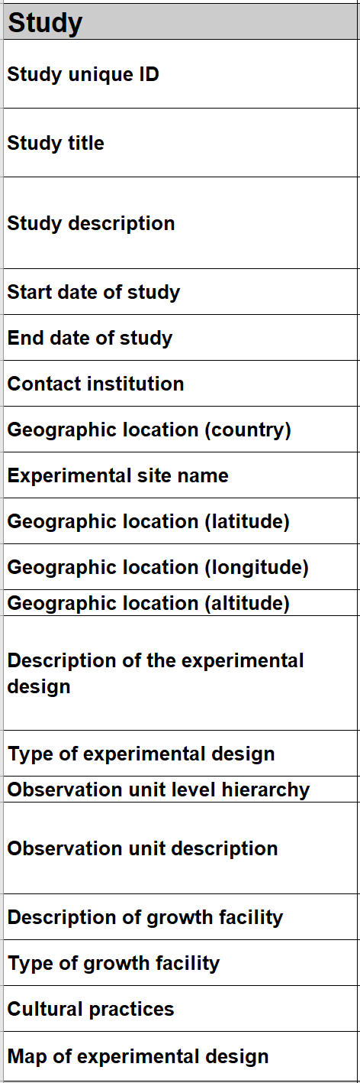
MIAPPE main sections – Study
A "study" (or experiment)
Comprises a series of assays (or measurements) undertaken to answer a particular biological question
One study = one location
Metadata: all the informations describing the experiment as a whole
=> timing, location, statistical design, cultural pratices, etc...
Examples:
MAIZE [1] : 29 studies => 2 years x 7 locations x 2 treatments (Gaillac 2012 rain, Gaillac 2013 watered, …)
POPLAR [2] : 6 studies => 3 locations over 2 years (Ardon_2003-2004, Ardon_2004-2005)

Slide 36
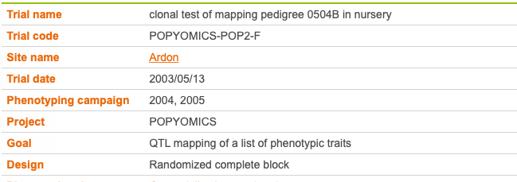
MIAPPE v1.1 Study Metadata
Poplar Study
In that example Study = Trial
Study

Slide 37
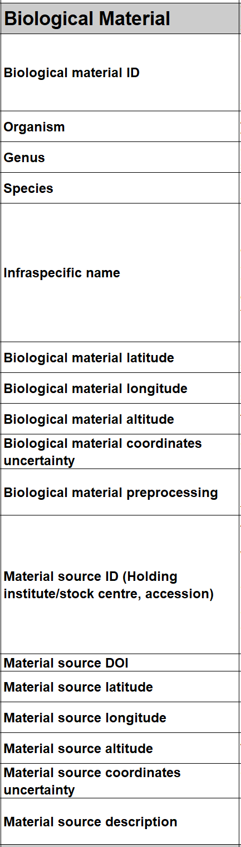
MIAPPE main sections – Biological material
Biological material being studied
Plus its source (stock center, gen bank, etc…).
Crucial for integrating phenotyping data with genomic or genetic data.
Metadata
Minimal fields from Multicrop Passport Descriptor (MCPD) standard
GPS location for forest tree / in situ material provenance
Source of the material used: accession, cultivar/variety, region of provenance, laboratory cross, ...
MCPD identification system:
Genebank/Lab + Species + accession number (mandatory)
DOI
Biological material used in the study: seed lot, cuttings…
Lab + internal accession number (mandatory)
URI
Plant Samples used in the study: detached leaves, ...
Lab + internal accession number (mandatory)
BioSample ID

Slide 38
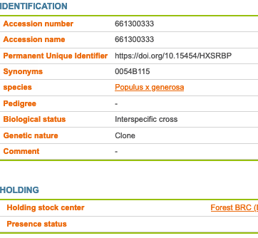
MIAPPE main sections – Biological material
Plant Material
Identification
Description
Multi Crop Passport Descriptor
Biological material
Observation Unit
Sample

Slide 39
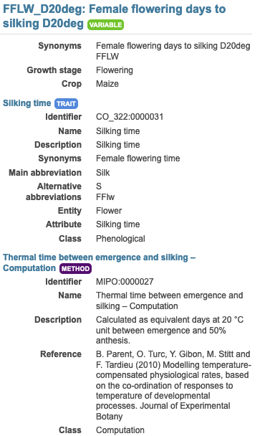
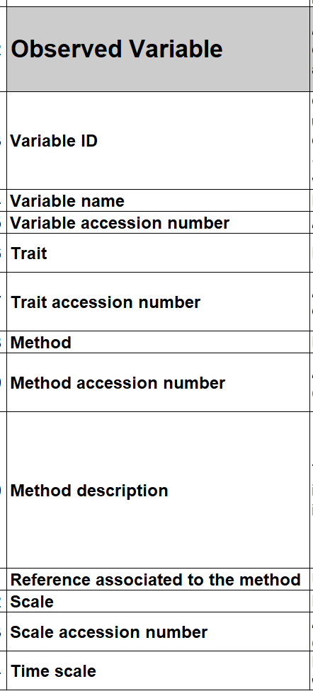
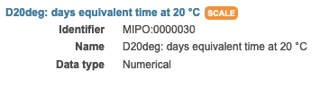
MIAPPE main sections – Observed Variable (Assay)
An Observed Variable (assay)
specific measurement.
trait
Measurement / computation method
Unit or notation scale.
Trait: Phenotype or Environment
Metadata
Crop Ontology Trait Dictionary
trait, method, scale
Example:
In each study of Millet et al. [1] :
Plant level: 20 variables
Genotype/ Study level: 19 variable both phenotype and environment
Plot level: 9 variables
E.g. Female flowering days to silking D20deg
E.g. Plant height (cm)

Slide 40
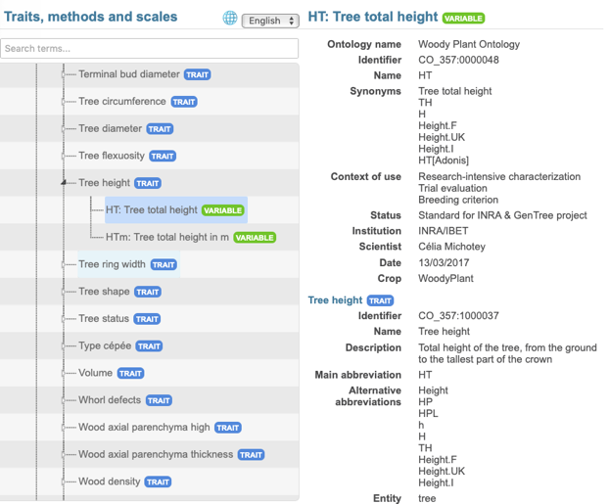
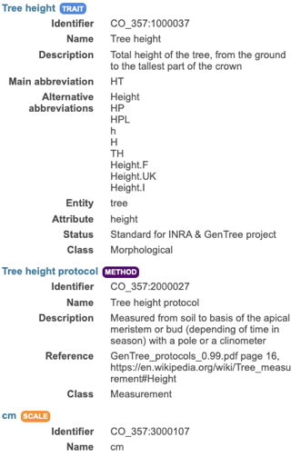
MIAPPE v1.1 Metadata
Observed Variable: Trait + Method + Scale
Assay
(Observed variable)

Slide 41





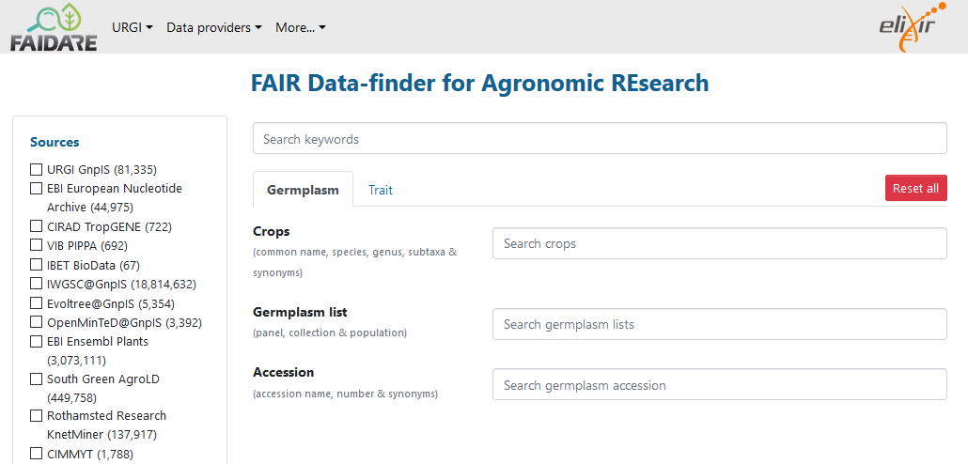
Data Integration between silos, From Phenotyping to Genotyping
Phenotyping DB
Material Source IDs
Material Source DOI
Material Source latitude
Infraspecific name (Riesling, Chasla, …)
Biological Material ID
Alternate IDs (project)
Material Source IDs
Material Source DOI
Material Source latitude
Infraspecific name (Riesling, Chasla, …)
Biological Material ID
Alternate IDs (project)
https://urgi.versailles.inrae.fr/faidare/
Community data discovery portals

Slide 42





















Acknowledgments
Elixir Plant community & platforms
Beier S., Gruden C., Pommier C., Coppens F, Scholz U., Lange M., Contreras B., Adam Blondon AF, Faria D, Chavez I, Miguel C, Droedsbek B, Finkers R, Papoutsoglou E, Olster R, Ramsak Z, …
H2020 AGENT
N. Stein (IPK, coord), P. Kersey (RBGK), M. Alaux (INRAE), S. Weise (IPK), C. Pommier (INRAE), M. Lange (IPK), R. Finkers (WUR), J. Destin (INRAE)
MIAPPE community
ELIXIR Plant Community,
Krajewsky P, Cwiek H, Tardieu F, Usadel B, Arend D, Arnaud E, Junker A, King G, Laporte MA, Poorter H, Reif J, Rocca-Serra P, Sansone SA, Kersey P,
And many more!
Crop Ontology
Arnaud E, Laporte MA, …
Breeding API
Selby P, Mueller L, Robbins K, Backlund JE, … ,
And many more!
Emphasis
Tardieu F, Usadel B, Arend D, Junker A, Poorter H, Neveu P, Pierushka R, Shur U…
And many more!

Slide 43
Questions

